Slide 1


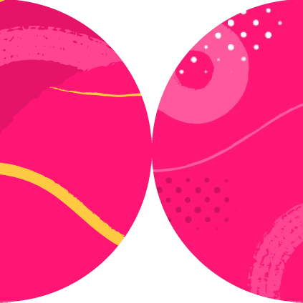

Using Locators

Slide 2

<form>
<div class="form-group">
<label for="nameInput">Name</label>
<input type="text">
</div>
<button type="submit">Submit</button>
</form>

Slide 3
Playwright.dev
Prioritize user-facing attributes and explicit contracts

Slide 4

.filter(new Locator.FilterOptions().setHasText("Item 2"))
<ul>
<li>
<p>Item 1</p>
<button>Add</button>
</li>
<li>
<p>Item 2</p>
<button>Add</button>
</li>
</ul>

Slide 5
iframe[id=bar]
var button = page
.frameLocator('#bar’)
.getByRole(AriaRole.BUTTON)
button

Slide 6

Summary
Prefer user-facing ways to locate elements
.locator(“#someId”)

